Slide 1
MIS6030 APPLICATIONS DEVELOPMENT
By
L. Mutanu

Slide 2
Java - what you need to know
Originally called Oak it was developed for home appliances driven by the desire for a cross platform tool
The development of HotJava web browser that could run “programs over the Internet” called applets made it popular. Java applets are now very rare. Programs on the internet now run on web servers.
Netscape soon included Java VM in Navigator web browser thus growing the popularity further
There is no relationship between Java and JavaScript. JavaScript is only a web design scripting language given that name purely to capitalize on Java the java hype. Java is a general-purpose application programming language.

Slide 3

The Java Programming Language
Java is part of the C family. Same syntax for variable declarations, control structures
Java came at a time when C++ was king. C++ was a notoriously complex object-oriented extension to C. Java improved on several key aspects of C++, greatly simplifying software development
Two most compelling features of Java were cross-platform deplorability (“write once, run anywhere”) and automatic garbage collection. These two advantages, especially garbage collection1, drove Java adoption

Slide 4
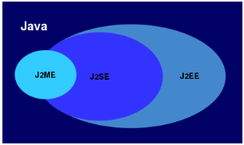
Distributions
Java, as many programming languages, has
suffered changes along its history. Today,
Java have three main distributions with their particular features:
J2SE - Java 2 Standard Edition. Oriented to the development of client-server applications. Does not include the technologies for web applications. It is the base for the other two distributions and is the most used platform.
J2EE - Java 2 Enterprise Edition. Oriented to the enterprises and the consolidation of their information systems. Do include the technologies for web applications (server and client side). Its base is J2SE.
J2ME - Java 2 Micro Edition. Oriented to small mobile devices (phones, tablets). Does not include the technologies for web applications. Its base is J2SE but it have extra features.

Slide 5
The Java Platform
Three components of the Java platform:
The Java programming language - Java source files (ending in .java) are compiled to java bytecode files (ending in .class)
Source code (or source program): A program written in a high-level language such as Java. The input to the compiler program
Object code: The translated low-level program. The output from the compiler program, e.g., Java byte-code
The Java Virtual Machine (JVM) - Java bytecode is then interpreted (run) by the JVM. Because JVM on each platform accepts the same bytecode, java programs can run on any machine.
The Java standard library - The enourmous Java standard library (containing many Classes notably missing from C++) greatly reduces software development effort.

Slide 6
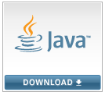
The Java SDK
Installing the JDK on your computer provides you with several tools, the most important of which are:
1. javac (SDK) - the Java compiler, which compiles .java files to create .class files
2. java (JRE) - the Java runtime program, which runs compiled .class files programs.
While the JRE is included in the JDK, they can be installed separately.

Slide 7
Anatomy of a Java program
Review:
Method
Output
Void
Main
This is all you need to know for now. Note:
Class
Public
Static
public class HelloWorld
{
public static void main()
{
System.out.println("Hello, world!");
}
}
NB:
The name of a java programs must be the same as the class name.
Java is a case-sensitive language

Slide 8
Compiling & Running a Java Program
After writing a program you need to compile it. Compiling converts source code (.java file) into object code (.class file).
Compiling helps the computer to identify syntax and semantic errors.
Syntax: The arrangement of words and punctuations that are legal in a language, the grammar rules of a language
Semantics: The meaning of things written while following the syntax rules of a language
After compiling, run the program. Running interprets the object code and reveals runtime errors. During running logical errors are also revealed.
Run-time error: An error that is not detected until a program is run
Logic error: A mistake in the underlying algorithm for a program

Slide 9
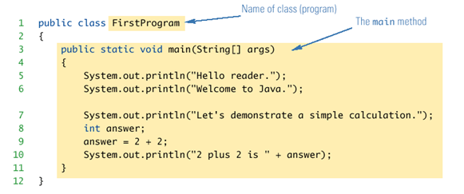
Manipulating output
Java programs work by having things called objects perform actions
System.out: an object used for sending output to the screen
The actions performed by an object are called methods
println: the method or action that the System.out object performs
Variable declarations in Java are similar to those in other programming languages. Simply give the type of the variable followed by its name and a semicolon int answer;
Exercise: Write a program that stores a word in a string variable and displays it.
Notes:
Java programs work by having things called objects perform actions
System.out: an object used for sending output to the screen
The actions performed by an object are called methods
println: the method or action that the System.out object performs

Slide 10
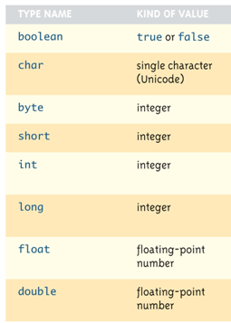
Variables Types
There is no primitive type for strings in Java. A string is treated as an object made up of several char variables. An object has variables in it as well as methods that can manipulate it.
The fact that a String is an object and not a variable means that it can do more than a variable. For instance we have many useful methods for manipulating strings
String greeting = "Hello";
int count = greeting.length();
System.out.println("Length is " + greeting.length());
Exercise: Modify the previous program to display the size of the word.

Slide 11
Arithmetic's in Java
As in most languages, expressions can be formed in Java using variables, constants, and arithmetic operators
These operators are + (addition), - (subtraction), * (multiplication), / (division), and % (modulo, remainder)
Similar to other programming languages assignment is from left to right
Exercise:
Write a program that can be used to convert a figure in Ksh to USD
public class Classwork {
public static void main(String[] args) {
int a=3;
int b=2;
int c;
c=a+b;
System.out.println(c);
}
}

Slide 12
Importing Packages and Classes
Libraries in Java are called packages
A package is a collection of classes that is stored in a manner that makes it easily accessible to any program
In order to use a class that belongs to a package, the class must be brought into a program using an import statement
Classes found in the package java.lang are imported automatically into every Java program

Slide 13
Input in Java
Starting with version 5.0, Java includes a class for doing simple keyboard input named the Scanner class
In order to use the Scanner class, a program must include the following line near the start of the file:
import java.util.Scanner
This statement tells Java to
Make the Scanner class available to the program
Find the Scanner class in a package named java.util
import java.util.Scanner;
public class Classwork {
public static void main(String[] args)
{
Scanner s = new Scanner (System.in);
System.out.print("Enter a number");
int a=s.nextInt();
int b=s.nextInt();
int c;
c=a+b;
System.out.println(c);
}
}
To perform input:
1. Create an object to accept the data (lets call it s)
Scanner s = new Scanner (System.in);
2. Accept the data –
int a=s.nextInt(); nextInt() reads one int or use next() to read one string
Exercise: Write a program that can be used to ask the user for their name and then it displays this name.

Slide 14



Control Structures in Java
Control Structures are used to manipulate the flow of control.
As in most programming languages, flow of control in Java refers to its branching and looping mechanisms
Branching - Java has several branching mechanisms: if-else, if, and switch statements
Looping - Java has three types of loop statements: the while, do-while, and for statements

Slide 15
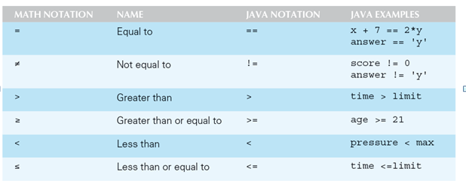
Boolean Expressions
Most branching and looping statements are controlled by conditions known as Boolean expressions
A Boolean expression evaluates to either true or false

Slide 16
Decision - Program asks you for a score and displays and displays a PASS or FAIL verdict
Loops – Program asks you for five scores and displays them
public class Classwork {
public static void main(String[] args) {
Scanner s = new Scanner (System.in);
System.out.print("Enter a test score");
int a=s.nextInt();
if (a > 60)
{
System.out.println("PASS!!");
}
else
{
System.out.println("FAIL");
}
}
}
public class Classwork {
public static void main(String[] args) {
Scanner s = new Scanner (System.in);
For (int i=0; i<5; i++)
{
System.out.print("Enter a test score");
int a=s.nextInt();
System.out.println(a);
}
}
Exercise:
Modify the first program to enquire if the user would like to enter another score before exiting.
Write a program that prompts the user for a number and then informs them if it is odd or even

Slide 17
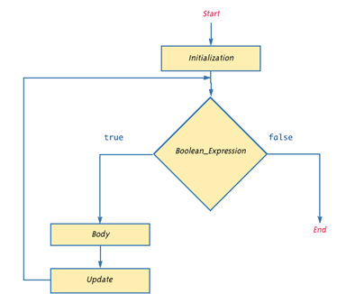
Algorithms and Pseudocode
The hard part of solving a problem with a computer program is not dealing with the syntax rules of a programming language, but rather, coming up with the underlying solution
An algorithm is a set of precise instructions that lead to a solution
An algorithm is normally written in pseudocode, (which is a mixture of programming language and a human language, like English) or illustrated using symbols such as flowcharts
Exercise:
Design an algorithm for a program that prompts the user for a number and then informs them if it is odd or even using a flow chart.
Design an algorithm for a program that prompts the user for a score and informs them that they have passed if the score is grater than 60%. The program should ask the user if they would like to enter another score before exiting.

Slide 18
Design an algorithm for a program that prompts the user for a number and then informs them if it is odd or even using a flow chart.
Start
Input a
C=a%2
C=0
Output even
Output odd
end

Slide 19
Introduction to Arrays
An array is a data structure used to process a collection of data that is all of the same type
An array behaves like a numbered list of variables with a uniform naming mechanism
It has a part that does not change: the name of the array
It has a part that can change: an integer in square brackets
For example, given five scores: score[0], score[1], score[2], score[3], score[4]
created using a statement as follows:
int[] score = new int[5];
The individual variables are called elements of the array and are identified by a number called an index numbered from 0

Slide 20
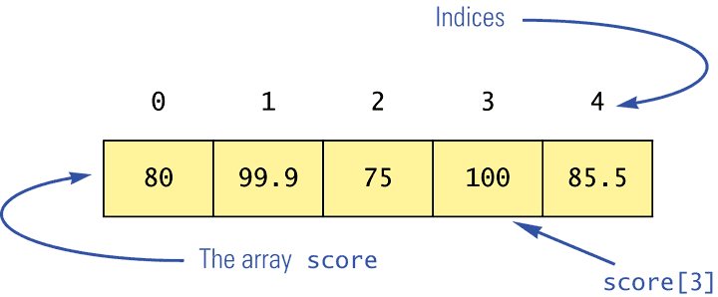
class ClassWork
{
public static void main(String[] args)
{
double[] score = new double[100];
score[0] = 80;
score[1] = 99.9;
score[2] = 75;
score[3] = 100;
score[4] = 85.5;
System.out.println(score[0] );
System.out.println(score[1] );
System.out.println(score[2] );
System.out.println(score[3] );
System.out.println(score[4] );
}};
Exercise:
Modify the program to ask the user to key in the scores. It should then display the scores. Use a loop for input and display.

Slide 21
Arguments for the Method main
Instead of creating an array using a single statement like:
int[] score = new int[5];
An array can also be created using two statements like:
int[] score; // create an array called score
score = new int[5]; // specify the size
Recall main function is always declared as follows:
public static void main(String[] args)
This means that main is ready to receive a parameter that is a String array called args (by convention). It enables main to receive arguments from the keyboard when running the program. If none are supplied then a default empty array of strings is automatically provided

Slide 22
Here is a program that expects three string arguments:
class ClassWork
{
public static void main(String[] args)
{
System.out.println(args[0] + " " +
args[2] + args[1]);
}
}
To supply the arguments (from netbeans)
right click on the project name and choose the properties option,
In the project Properties dialog box we will have to choose the Run node from the left.
In the Arguments text box we have to type our command line arguments separated by a space.
Run the program
Note that if it needed numbers, it would have to convert them from strings first

Slide 23
Problem Solving Exercises:
Write a program that allows the user to insert 10 numbers into an array and informs you which is the largest
Add a find method to the program that accepts a number to search for from the user and displays a message to inform the user if the number was found.
Modify the program to make use of a method to create an array and insert data into the array. It should then return the array to the main for main to find the largest.
Modify the program to receive the array data as arguments to the program.
Modify the program to sort data in the array before displaying them
Notes:
public double[] getArray()
{
double[] temp = new double[count];
for (int i = 0; i < count; i++)
temp[i] = a[i];
return temp
}

Slide 24
Sorting an Array
A sort method takes in an array parameter a, and rearranges the elements in a, so that after the method call is finished, the elements of a are sorted in ascending order
There are various ways to sort data in an array. You could use a bubble sort, selection sort or an insertion sort algorithm.
A selection sort accomplishes this by using the following algorithm:
The simplified algorithm would be:
Go through the array comparing recording
the smallest
Swap at the end
Repeat this process N-1 times
int i, j, min;
for(i=0; i<4; i++) // repeat the process
{min = i; // minimum
for(j=i+1; j<5; j++) // comparison
{if(a[j] < a[min] ) // if min greater,
min = j; // we have a new min
}
long temp = a[i];
a[i] = a[min];
a[min] = temp;}
Exercise: Write a program that inserts 10 values into an array then sorts and displays the sorted array

Slide 25
Multidimensional Arrays
It is sometimes useful to have an array with more than one dimension e.g. two or three or more
Multidimensional arrays are declared and created in basically the same way as one-dimensional arrays, however each index must be enclosed in its own brackets to represent the position in the dimension
double[][] myArray = new double[100][10];
int[][][] myArray = new int[10][20][30];

Slide 26
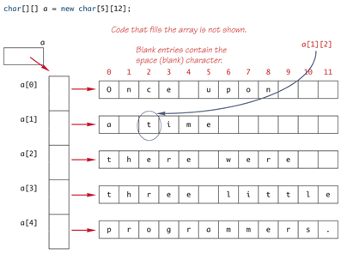
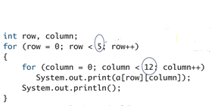
An example of a two dimensional array and how to display data from it.
Exercise:
Create a two dimensional array that can be used to capture the names of five items in a retail store, the buying, and the selling price of each. The program should then calculate the profit and store it along side each item. Finally the program should display the array with the four fields.

Slide 27
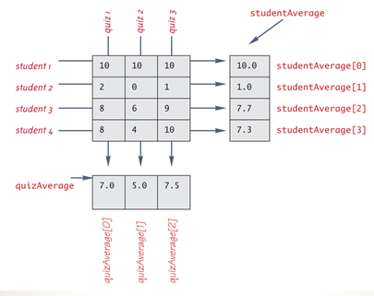
Exercise: Implement the following illustration using a single array. The program should prompt the user for the scores and calculate the student average as well as the average for each quiz and store them in the array as shown.

Slide 28
Methods
There are different kinds of methods:
Methods that perform an action
This type of method does not return a value, and is called a void method
Methods that compute and return a value
Methods that require data to work
Each type of method differs slightly in how it is defined as well as how it is (usually) invoked:
A void method uses the keyword void in its heading to show that it does not return a value : public void methodName()
A method that returns a value must specify the type of that value in its heading: public typeReturned methodName()
A method that requires data to work must accept parameters: public void/returntype methodName(paramList)
Design a simple calculator as a console program. The main method should accept two numbers from the user as well as an arithmetic operator. The main method should also display the calculated results. The program should have separate methods for addition, subtraction, multiplication and division.

Slide 29
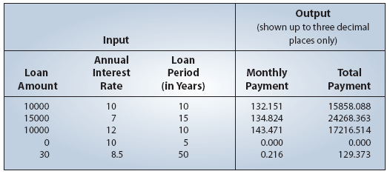
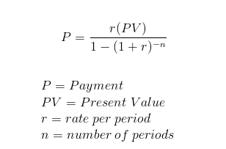
Problem Statement
Write a loan calculator program that computes both monthly and total payments for a given loan amount, annual interest rate, and loan period.
Use three methods:
Get three input values: loanAmount, interestRate, and loanPeriod.
Compute the monthly and total payments.
Output the results.
The output should be:
Hint:
Java - pow() Method - The method returns the value of the first argument raised to the power of the second argument. Syntax: double pow(double base, double exponent)

